Slide 1


Slide 2

High School League
Definition
High School league adalah sebuah liga esports dengan Dota 2 sebagai game utama. Namun akan selalu ada kemungkinan bertambahnya cabang game di musim berikutnya. Liga akan berlangsung selama 1 semester dan akan diadakan pertandingan setiap Sabtu dan Minggu.
Objectives
Menjadi pencetus liga pelajar di Indonesia
Memperkenalkan industri digital melalui esports
Memperkenalkan karir yang ada di industri digital
Mencari bibit-bibit atlit esports
Membentuk mental dan attitude atlit esports

Slide 3
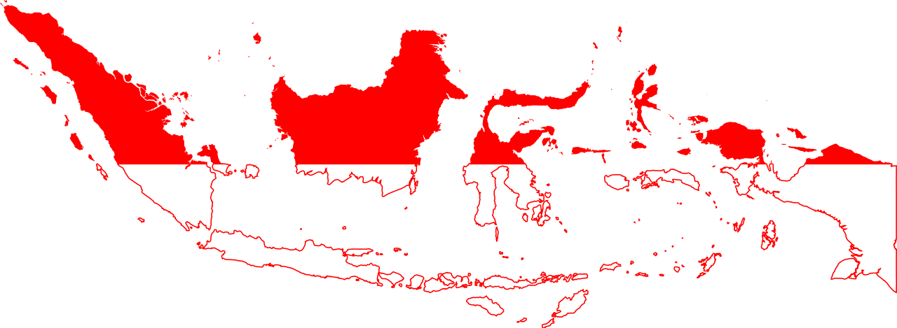
Participant HSL since July 2018
SUMATERA
96 School
KALIMANTAN
41 School
SULAWESI, 27 School
548
School Participant
Total: 35 Cities
Total Dota 2 Team: 264 Team
1.320 Student
Total MLBB Team: 392 Team
1.960 Student
JAWA, 377 School
BALI, 7 School

Slide 4
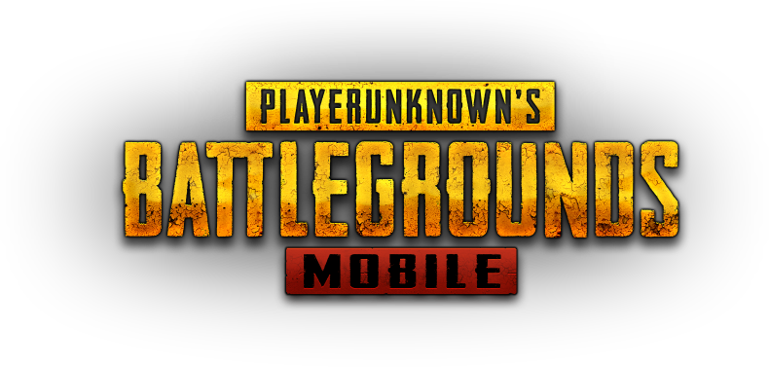

High School League Games
GAME
GAME
GAME
1
2
3
MAIN GAME
DOTA 2
SYSTEM
QUALIFIER & LEAGUE
PRIZE POOL
RP. 360.000.000 / SEASON
EXHIBITION GAME
PUBG MOBILE
SYSTEM
BEST OF ONE
PRIZE POOL
RP. 50.000.000 / SEASON
MINI COMPETITION ( Roadshow )
PUBG MOBILE
SYSTEM
RANGKING and POINT
PRIZE POOL
Rp. 1.000.000/ ROADSHOW

Slide 5
High School League Timeline
JULY
AUG
SEPT
OCT
NOV
1
2
3
4
1
2
3
4
1
2
3
4
1
2
3
4
1
2
3
4
Pre Season Promo
Roadshow
Registration
Qualifier Dota 2
Dota 2 League
PUBGM Exhibition

Slide 6

High School League – SERI A
Juara 1
Beasiswa Rp. 30.000.000,-
Juara 2
Beasiswa Rp. 20.000.000,-
Juara 3
Beasiswa Rp. 10.000.000,-
Total Hadiah:
Rp. 360.000.000,-

Slide 7
High School League – Exhibition
Juara 1
Beasiswa Rp. 25.000.000,-
Juara 2
Beasiswa Rp. 15.000.000,-
Juara 3
Beasiswa Rp. 10.000.000,-
Total Hadiah:
Rp. 50.000.000,-

Slide 8
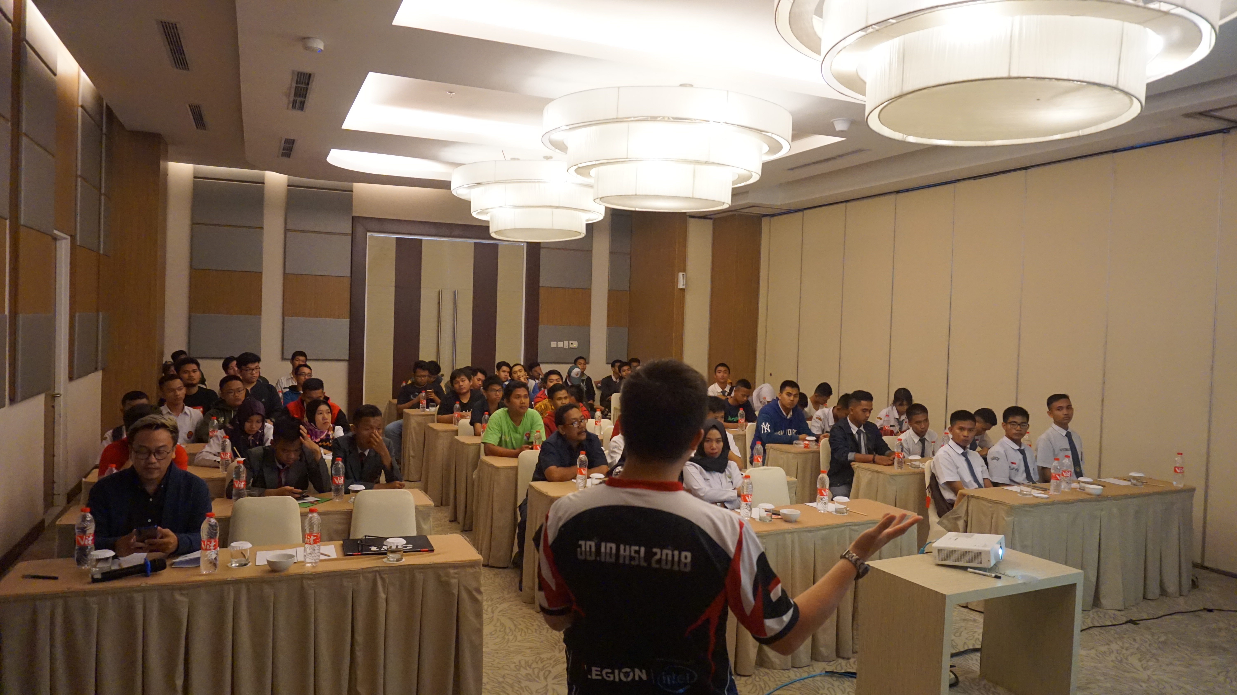
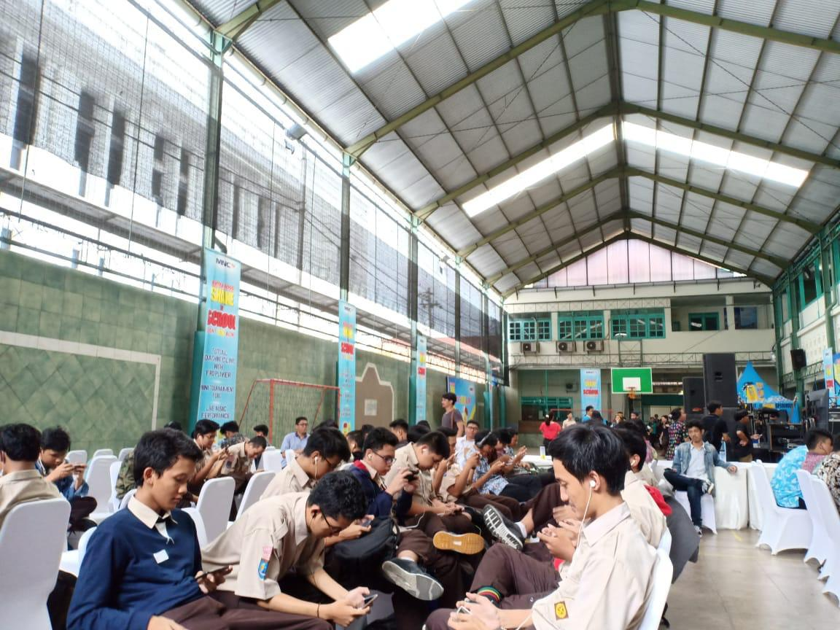
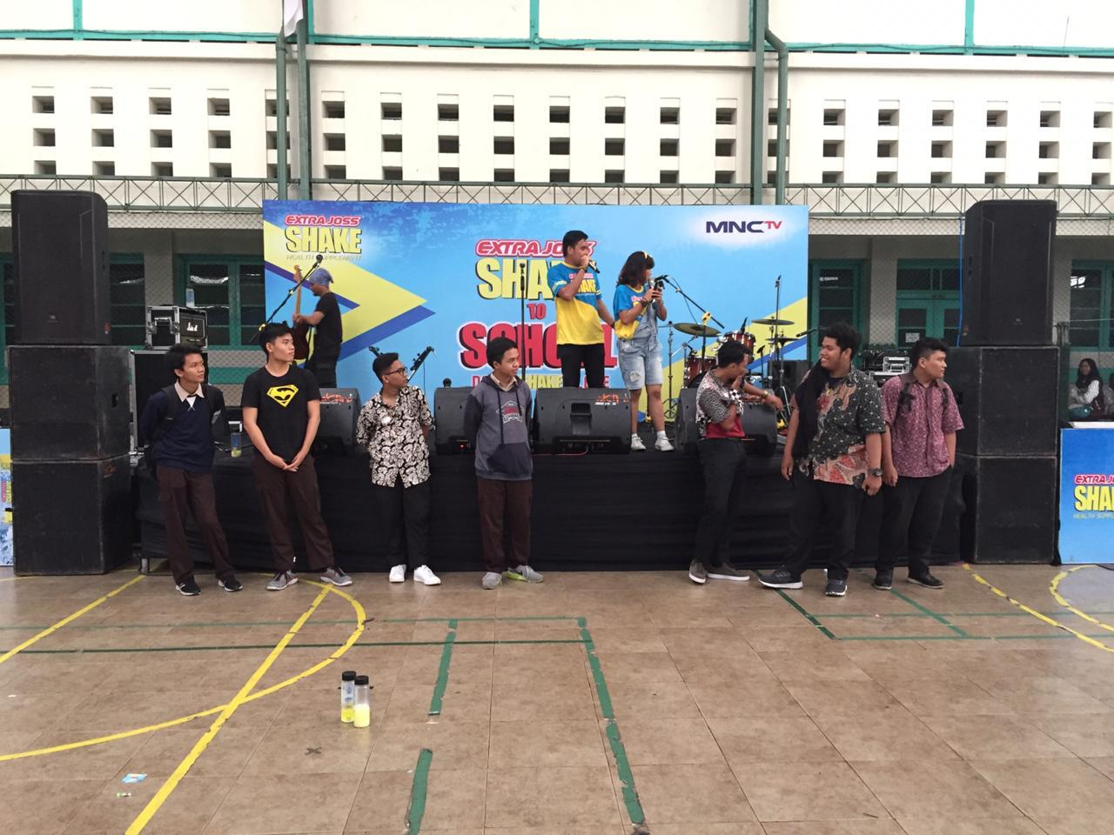
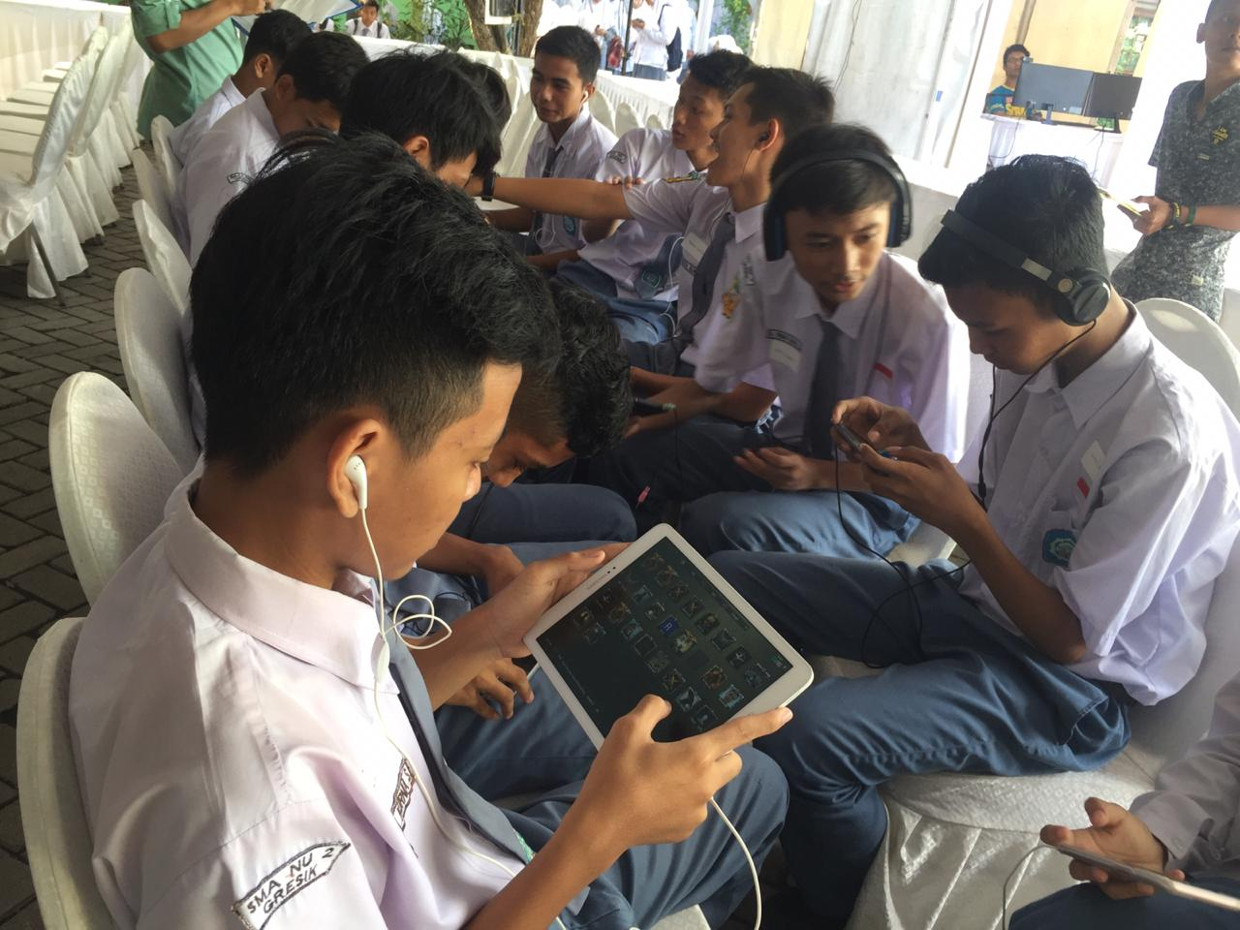
HSL Roadshow School Activity
Talkshow Digital Industri 4.0
Mini Competition
Entertaiment
Mini Competition

Slide 9
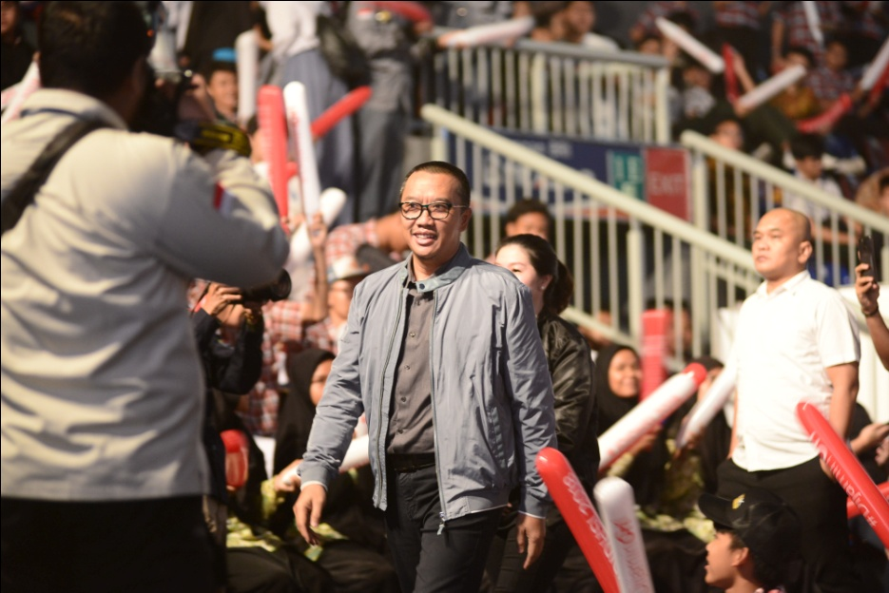
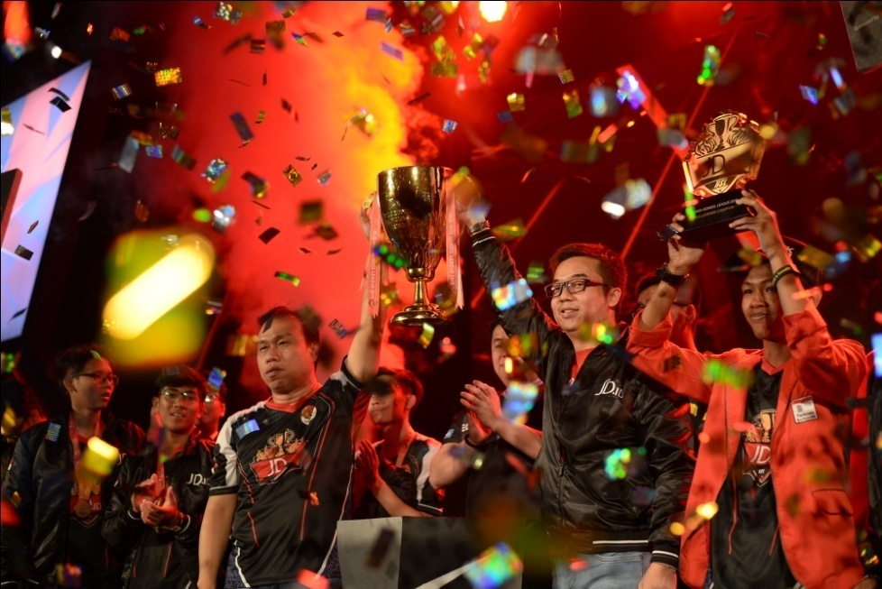
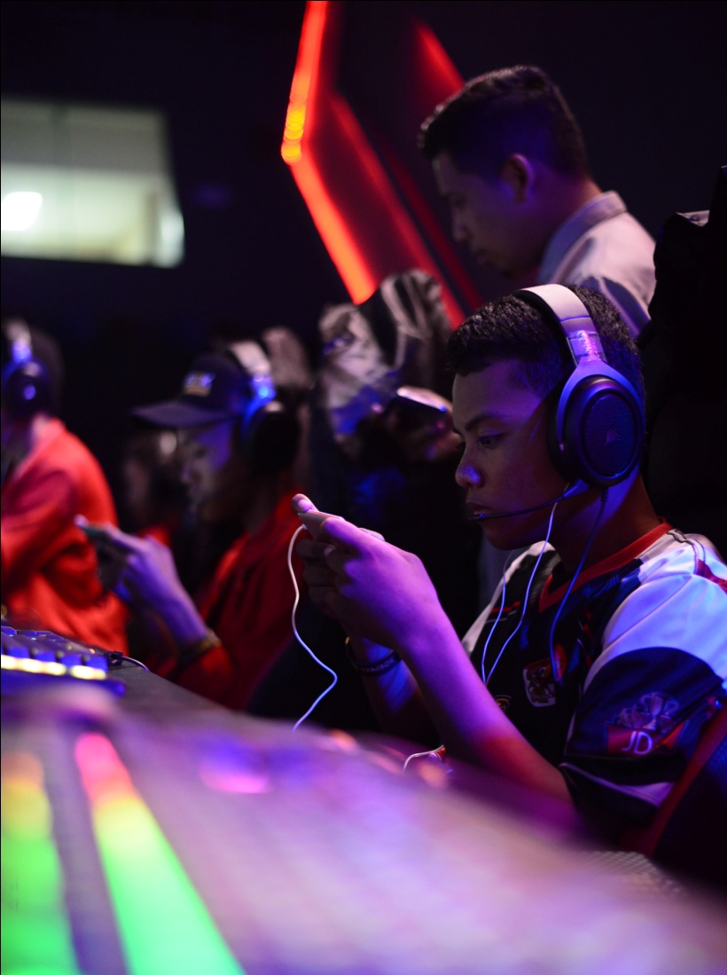
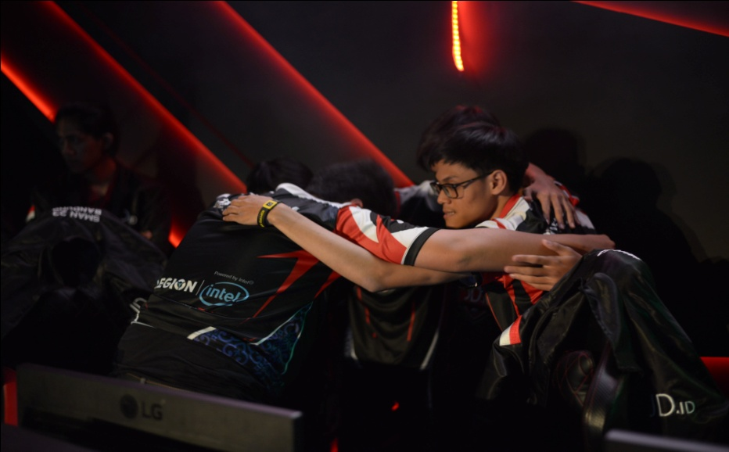
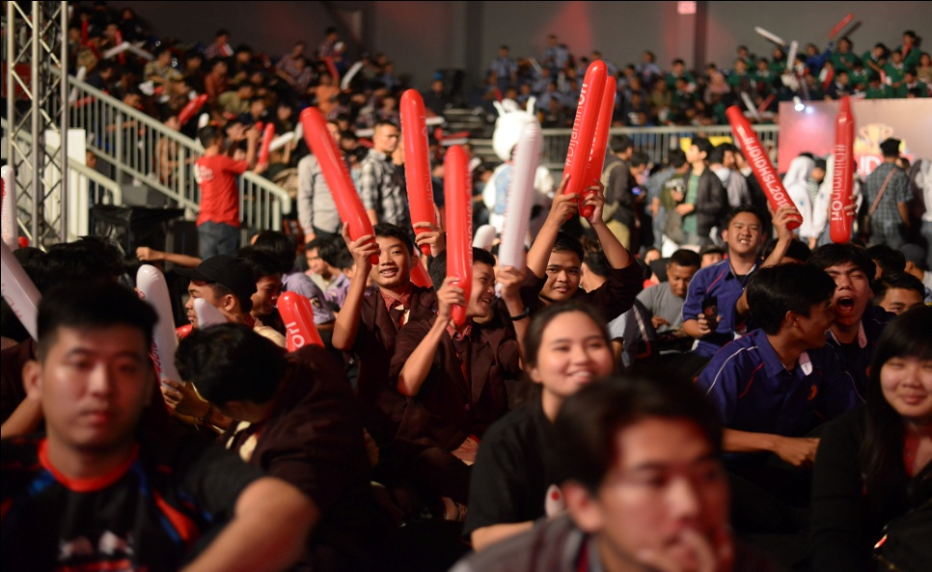
High School League Gallery

Slide 10
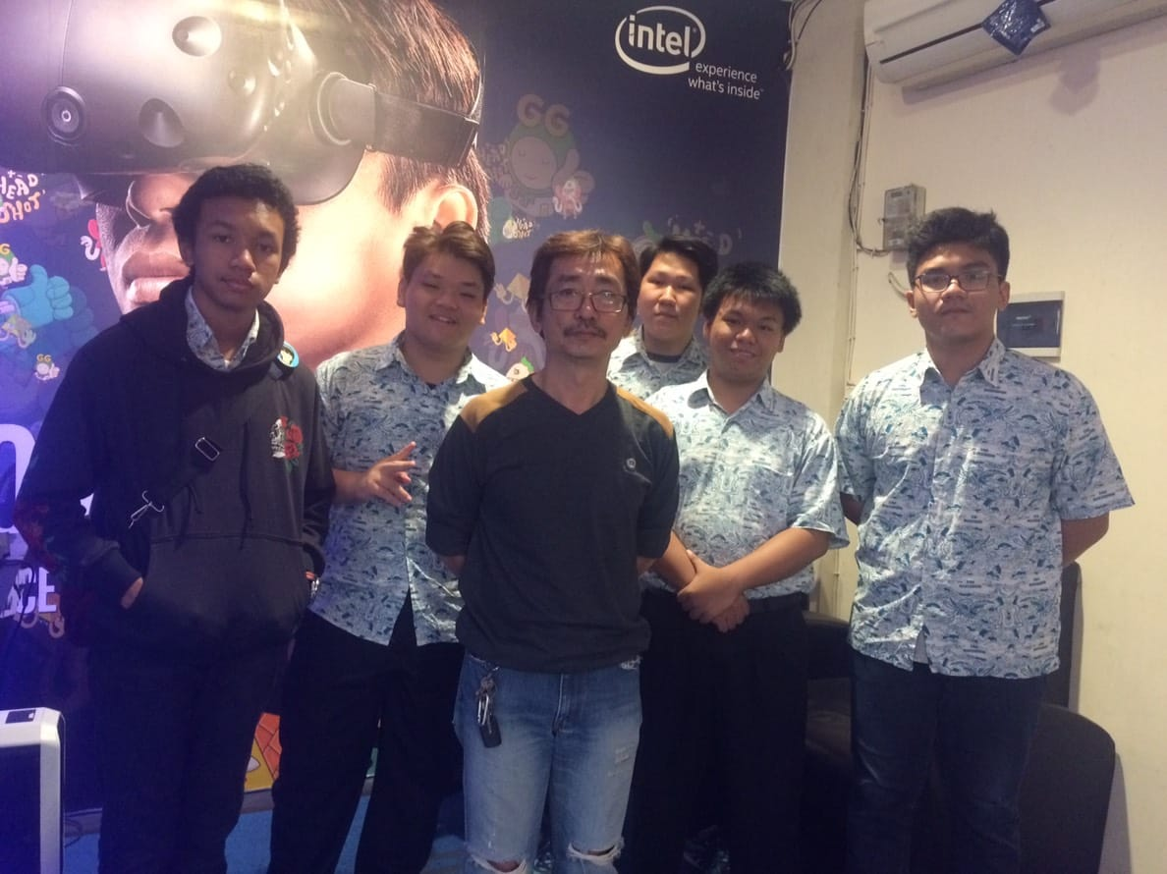
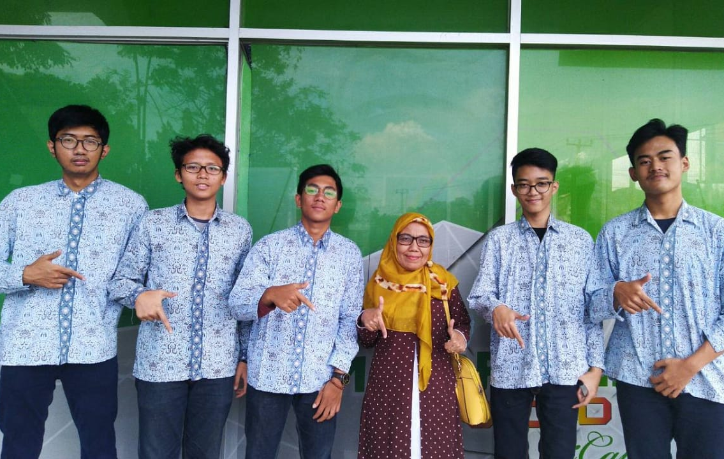
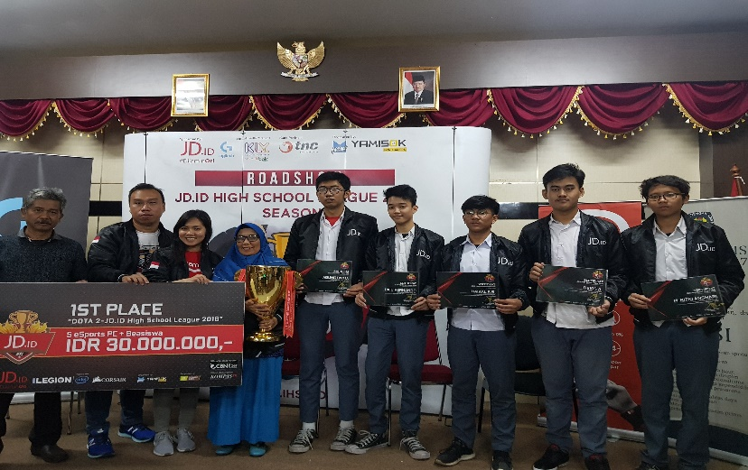
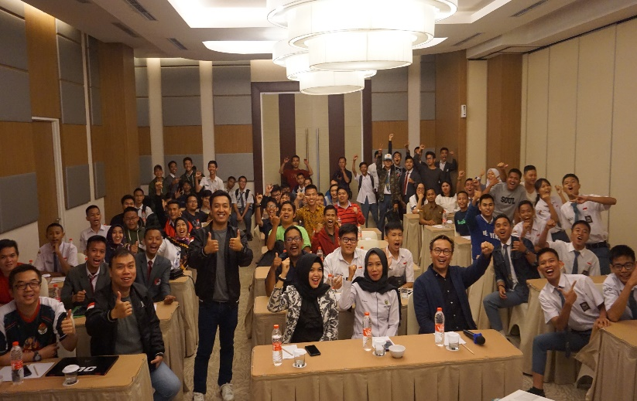
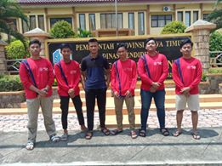
High School League Gallery

Slide 11



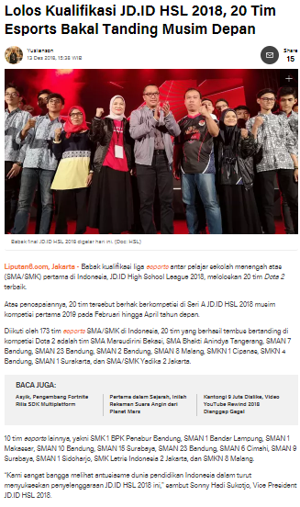
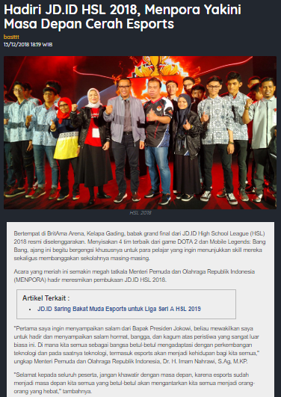
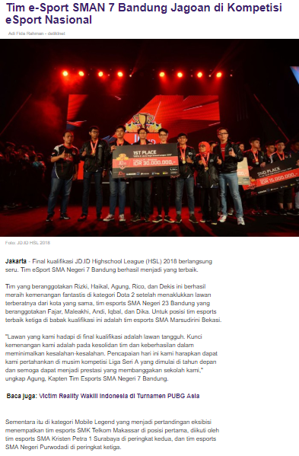
HSL Scaned Media Coverage

Slide 12



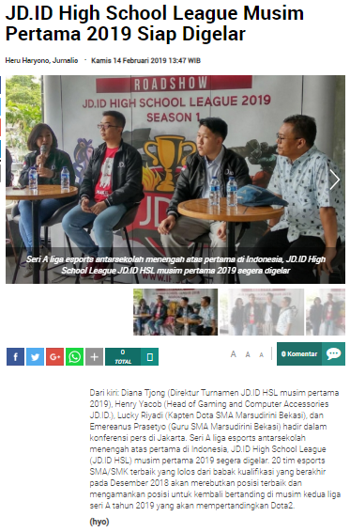
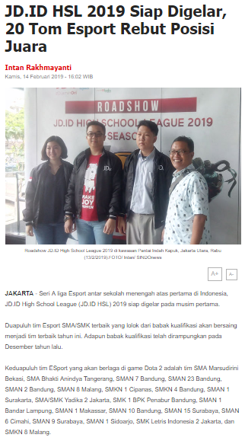
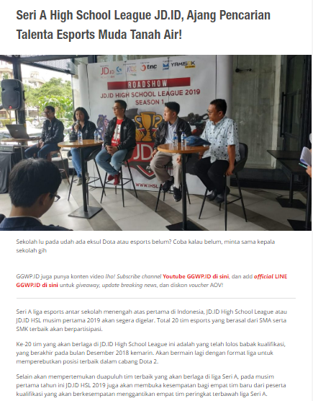
HSL Scaned Media Coverage

Slide 13

HSL Icafe Venue 2019 season 2
All I café below:
Total: 20 Cities

Slide 14













HSL Media Exposure
Potential Media Patner
Gaming Media
Mainstream Media

